Slide 1
English Writing II
Week 12 Writing of an Opinion Piece (Op-ed)

Slide 2

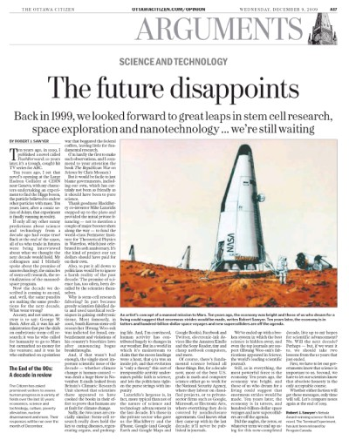

Slide 3

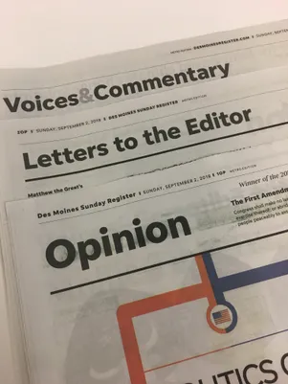
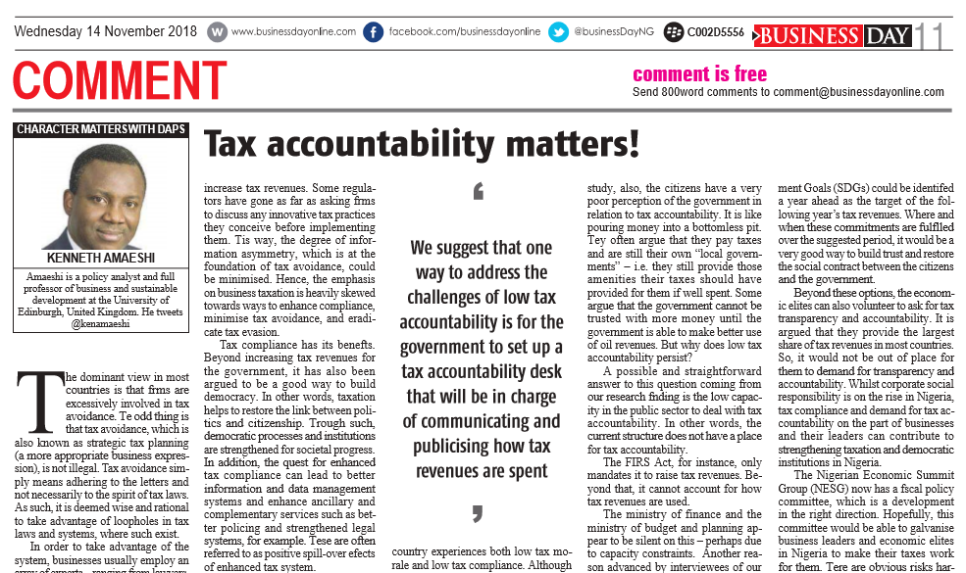

Slide 4
Opinion Piece
Opinion articles are sometimes called "op-eds," and these articles allow readers of a newspaper to voice their thoughts and ideas on topics ranging from local happenings to international controversy.
Around 750 words
https://www.wikihow.com/Write-an-Opinion-Piece

Slide 5
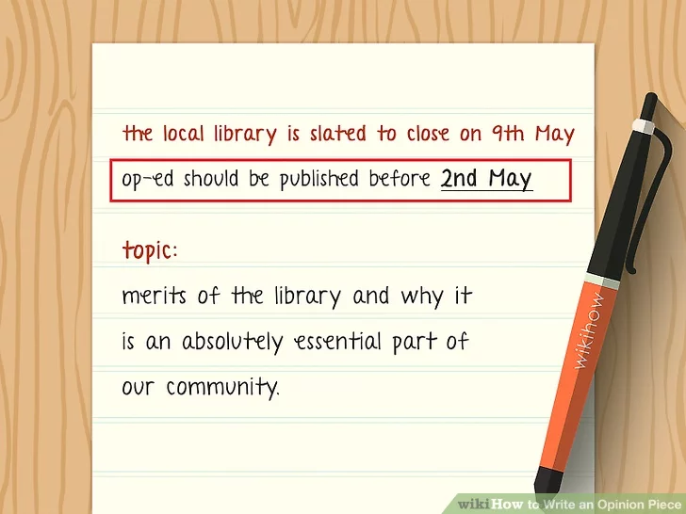
Choosing a timely topic

Slide 6

A topic you’re passionate about

Slide 7

A topic you’re knowledgeable about

Slide 8
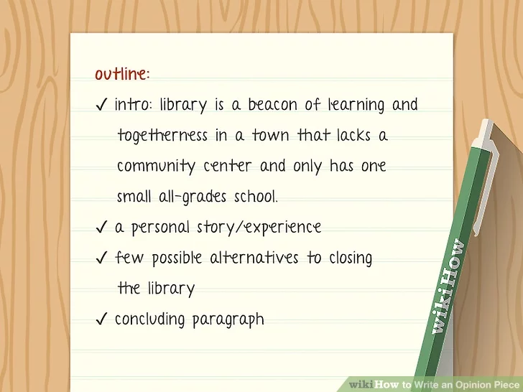
A complicated and multi-faceted topic

Slide 9

Get straight to the point

Slide 10

Rich and reliable details and examples

Slide 11

Justify the significance of the topic

Slide 12

Make it personal (and factual)

Slide 13

Acknowledging the counterarguments

Slide 14

Close strong

Slide 15
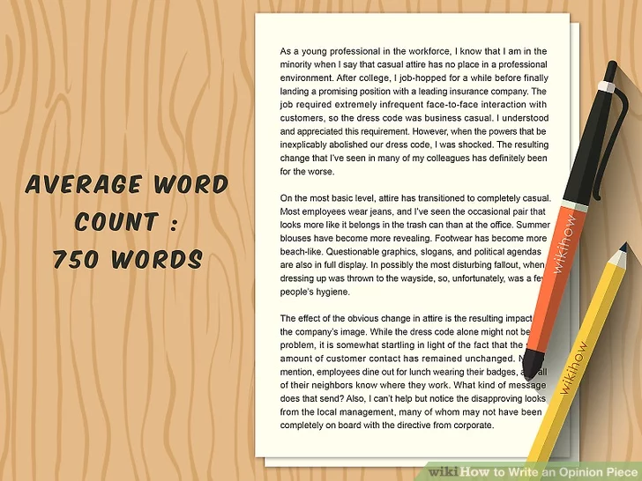
Keep the word count in mind

Slide 16
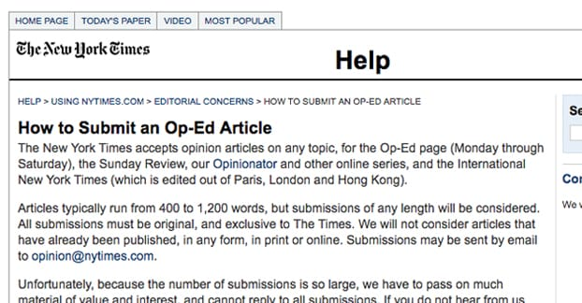

Slide 17
What counts as a good opinion piece?
1. The Point: Does it have a point that is clearly expressed? The Point may be a recommendation for action or it may be to alert readers to a problem. The author should make a single point well. The reader should be able to explain the author's message in a sentence or two.

Slide 18
What counts as a good opinion piece?
Persuasive: Does the piece persuade the reader? A good piece argues effectively for a particular point. Even though the reader may NOT ultimately agree with the author, the reader comes away from the piece willing to seriously consider the author's perspective.

Slide 19
What counts as a good opinion piece?
Hook and Structure: Does the opinion piece engage the reader right at the beginning? Is there evidence of thoughtful organization? Does the author summarize the main point at the end?

Slide 20
What counts as a good opinion piece?
Writing and Clarity: Is the piece readily understandable to non-academic readers? General readers should find the piece easy and interesting to read. There should be few grammatical and spelling errors.

Slide 21
What counts as a good opinion piece?
Tone: Is the opinion piece polite and respectful? The focus in on persuading the reader rather than voicing indignation or condemnation.

Slide 22
Summary
(1) Point
(2) Persuasive
(3) Hook and structure
(4) Writing and clarity
(5) Tone

Slide 23
In-class reading (15 minutes)
Two op-eds
OP-ED sample.docx

Slide 24
A final reminder
Start with a tie-in to the current event or personal experience
Give the readers something to take away
Mind your tones
Short and strong

Slide 25
Requirements for Project 2
Argumentation + (exposition, narration and description)
Factual evidence, supporting details & real-life examples
Specific technique: COUNTERARGUMENT +
800-1000 words

Slide 26
